Slide 1
Bellringer: In what ways did the British control the economy and people of the American Colonies?
The Steps to Revolution
October 7/8, 2013

Slide 2
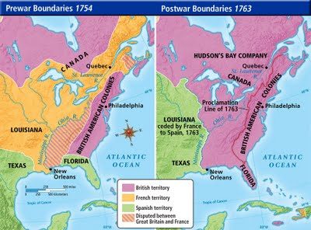
French and Indian War
British want to settle a fort in the Ohio River Valley but find French there already. War begins.
War spreads to Europe.
British won the war and the French lost all colonies in N. America.
But at what cost?

Slide 3
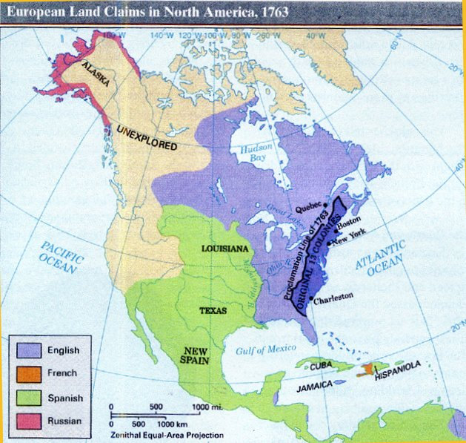
Proclamation of 1763
Many colonists wanted to move to the new claimed lands
Britain could not govern the land and said no to settlements west of the Appalachian Mtns.
This angered colonists who wanted to settle the land.

Slide 4
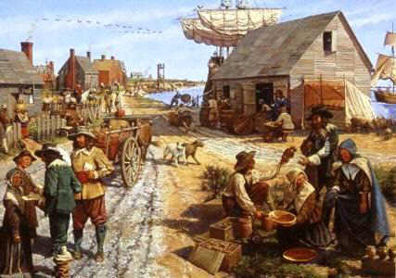
2nd Class Citizens?
Back in England, the people knew little about the colonies
Many thought the colonists could not care for themselves and were lower class citizens
Colonists wanted the same rights as Englishmen

Slide 5

Taxation Without Representation
Assemblies governed the colonies until after the French & Indian War
Britain now wanted to tax the colonies but would not give them representation in Parliament

Slide 6
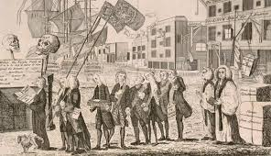
Stamp Act
England taxes the colonies directly for the first time
Many colonists did not feel as though England could tax them like this
British goods were boycotted until stamps were ignored and it was repealed

Slide 7
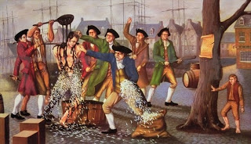
Townshend Acts
Charles Townshend believed that without taxes, the colonists would see the British as soft
These are a series of new taxes and laws

Slide 8
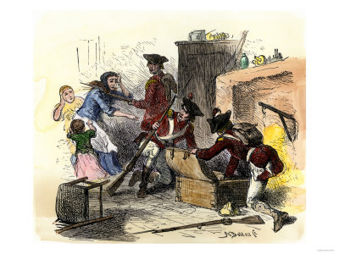
Quartering Act
Many British soldiers were sent to colonies to maintain order
This act allowed them to stay in any colonist’s home without their permission

Slide 9
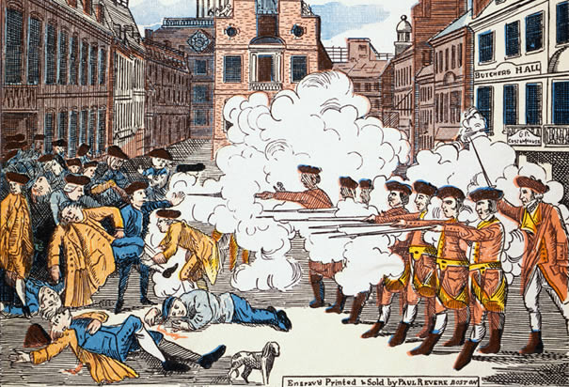
Boston Massacre
British soldiers in the colonies did not think highly of the colonists, and vise versa.
Soldiers patrolled the streets of angry colonists
5 colonists died after British soldiers fired into a crowed when they were taunted

Slide 10
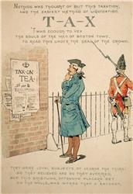
Tea Act
All the rights of tea sales were given to one British company, taking away rights of American merchants
Tea was boycotted by the colonists

Slide 11
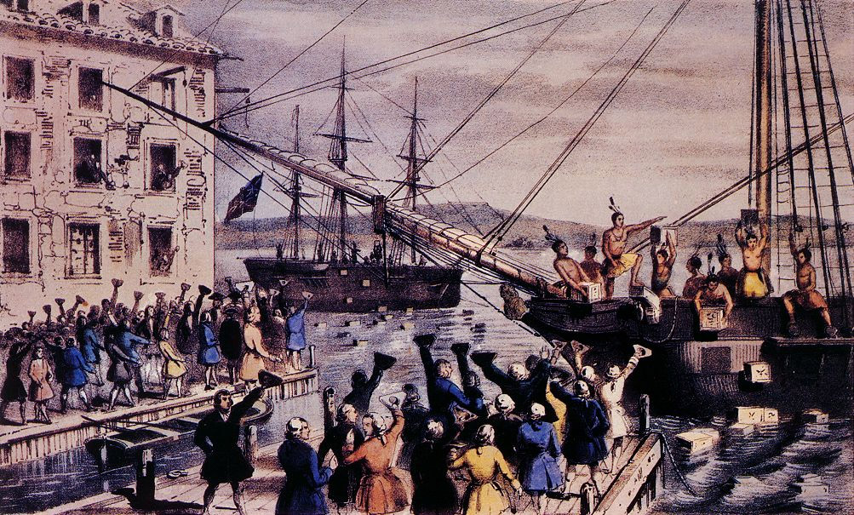
Tea Party
In Boston, the Sons of Liberty dressed as Mohawk Natives, went on a British Tea Ship, and threw it all overboard.

Slide 12
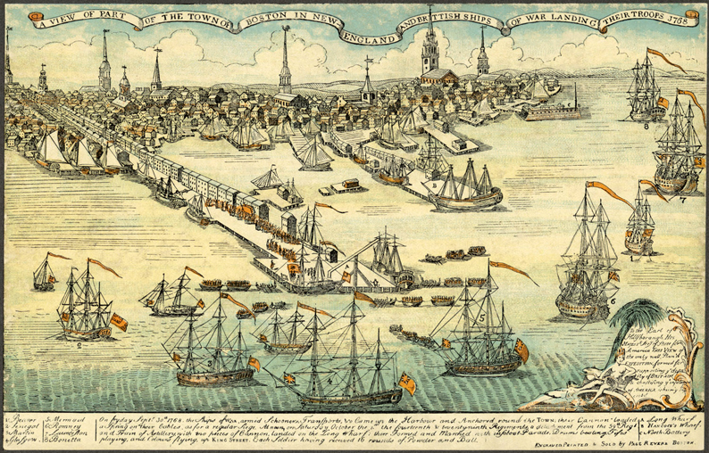
Intolerable Acts
Britain decided to punish Massachusetts for the Tea Party and make a statement to the other colonies
No ships could leave the harbors, the government was taken over by Britain
Colonists knew this wouldn’t happen to any town in Britain

Slide 13
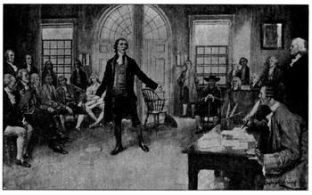
Continental Congress
A meeting of delegates from all of the colonies
All men had different opinions on how to achieve one goal, freedom
Dent shipments to Massachusetts
Formed Militias to fight the Intolerable Acts

Slide 14
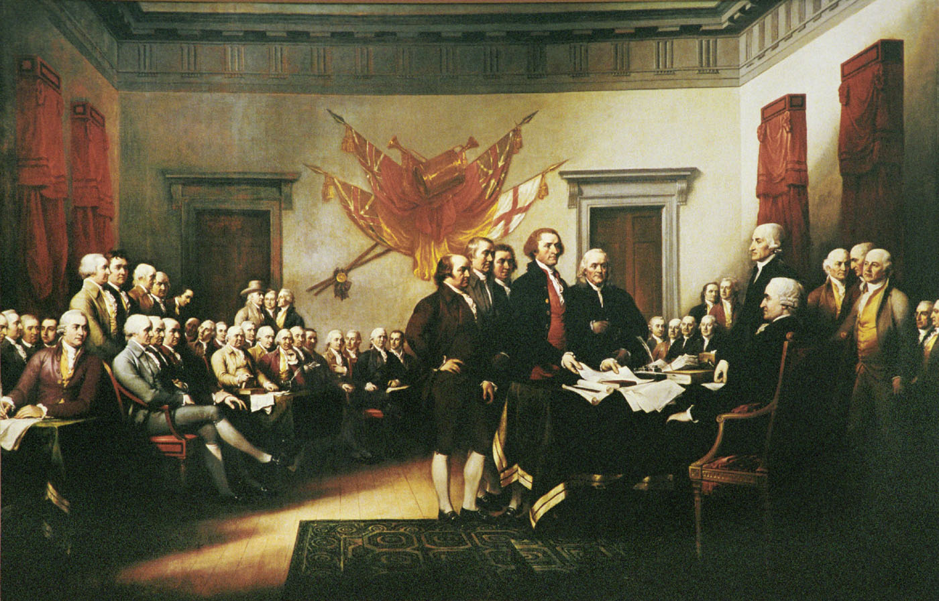
Declaration of Independence
Written by the First Continental Congress
Outlined the rights they believed colonists should have and their problems with the British Parliament
Was sent to King George III
Revolution was on the horizon!

